Slide 1
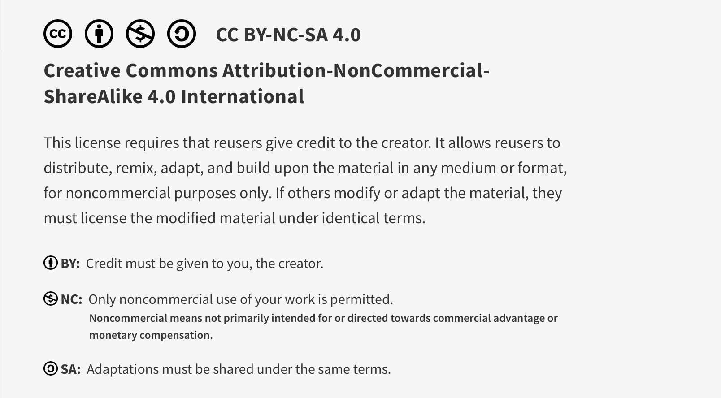
This work is licensed under CC BY-NC-SA 4.0. To view a copy of this license, visit: https://creativecommons.org/licenses/by-nc-sa/4.0/

Slide 2

Systems Approach to Quality and Safety: Pre-Session Material
Lucie Filteau, MD, FRCPC
PGY 2-4 Academic Half Day
QPS Series

Slide 3

The Safety Competencies
http://www.patientsafetyinstitute.ca/English/toolsResources/safetyCompetencies/Pages/default.aspx

Slide 4

Learning Objectives
To understand key concepts of complex systems and systems thinking
To recognize the impact of culture on systems and safety
To become familiar with the process of adverse event (A/E) investigation and analysis tools

Slide 5
Traditional Approach to Adverse Events
Discover a bad outcome
Determine who was at fault
Blame that individual
Tell the person not to do that again
Provide remedial training
Strengthen policy language
Severity of outcome dictates the severity of the mistake and severity of the consequences for the individual at fault

Slide 6
Resulting Individual Response to Error
Do nothing
Disguise
Deny
Defend
Deflect
Devolve

Slide 7
Systems Thinking
An approach to analysis that focuses on:
the way that a system’s constituent parts interrelate
how systems work over time and within the context of larger systems
Requires a shift away from linear thinking to a recognition of a dynamic, chaotic, interconnected array of relationships and feedback loops
Recognizes the whole and the parts as well as the connections b/w them
Recognizes that systems mapping is required prior to planning changes/interventions

Slide 8
Systems Thinking
Sees causality as a collection of influences rather than single factor
Systems approach looks at the conditions/environment in which individuals and teams work, and ALL the factors that might lead to an adverse event (A/E)
System components
People
Tasks
Equipment/technology
Physical environment
Organization and external environmental factors

Slide 9
“Every system is perfectly designed to get the results that it gets”
W. Edwards Deming, Bell Labs Engineer
Batalden’s & Berwick’s Central Law of Improvement. A Primer on the Improvement of Systems
https://www.jstor.org/stable/29730913

Slide 10
Complex Systems
Systems whose behaviour is intrinsically difficult to model due to the dependencies, competitions, relationships and other types of interactions between their parts, or between a given system and its environment
Examples:
Human beings (physiology, pathophysiology)
Economies
Environment
Healthcare system

Slide 11
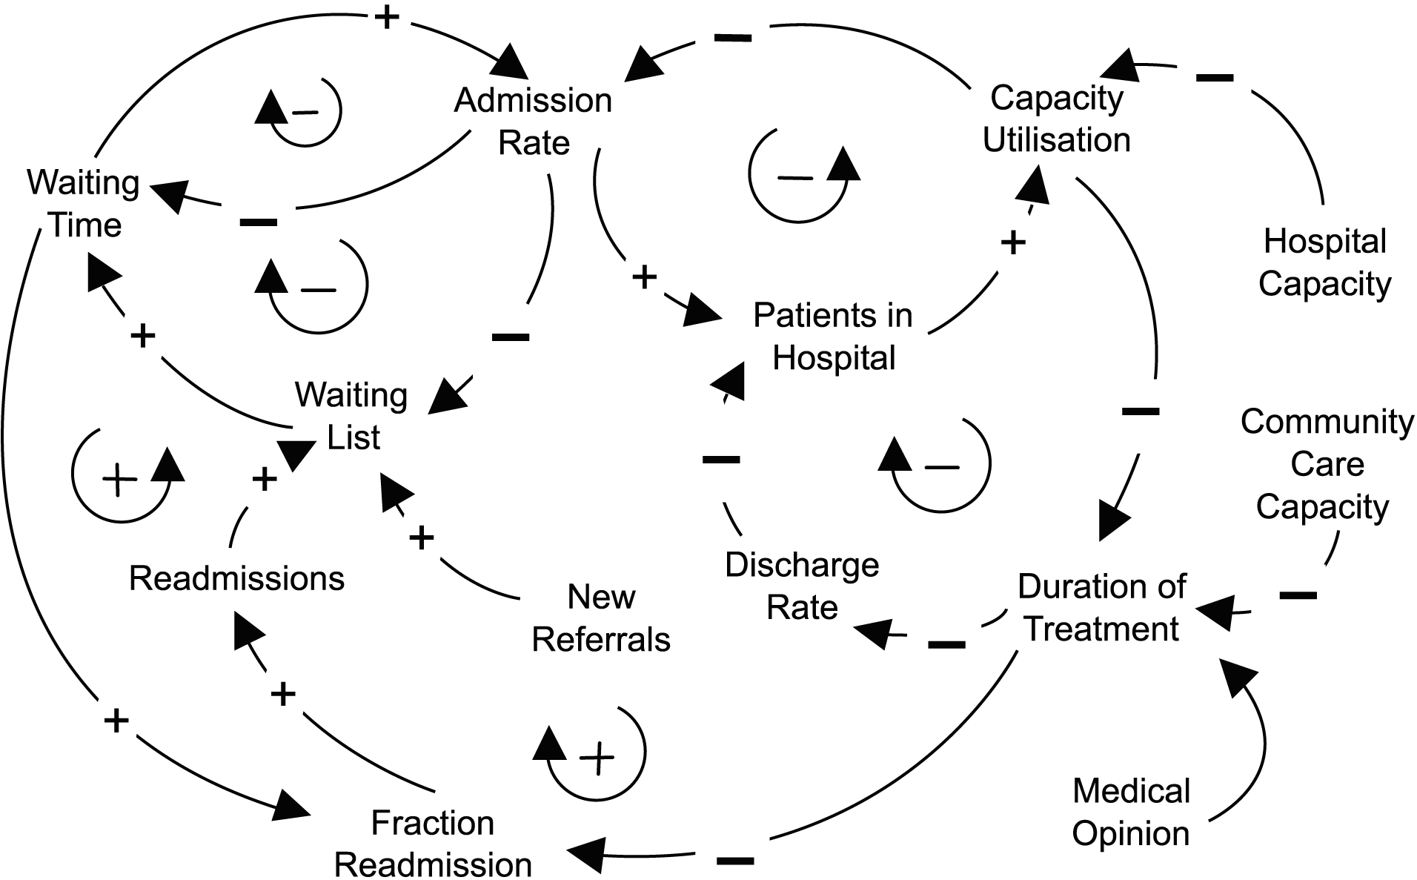
Example: Hospital Capacity for Inpatient Care
https://designforimpact.substack.com/p/three-ways-to-visualise-a-complex

Slide 12
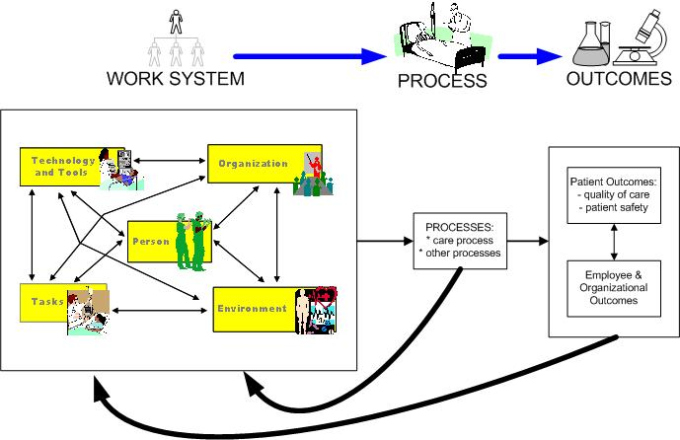
Model of a Work System Map
UW-Madison Systems Engineering Initiative for Patient Safety (SEIPS)
Carayon, P., Hundt, A. S., Karsh, B., Gurses, A. P. Alvarado, C. J., Smith, M., and Brennan, P. F. (2006).
Work system design for patient safety: the SEIPS model. Quality and Safety in Healthcare, 15(Suppl I), i50-i58.

Slide 13
“Learning” System
Feedback collected on system outputs
Feedback fed back to system for system improvements
Healthcare examples:
Infection rates
Readmission rates
Fall rates
Door to needle time (MI, CVA)
Patient satisfaction survey data
Personal performance data
Feedback loop ideally happens repeatedly

Slide 14
Organizational Culture
Defined as the underlying beliefs, assumptions, values and ways of interacting that contribute to the social and psychological environment of an organization
Directly and significantly shapes attitudes and behaviours
Examples of organizational cultures:
Team based vs hierarchical
Cooperative vs competitive (shark tank)
Nurturing vs “sink or swim”
Flexibility vs rigid, rule based

Slide 15
Safety Culture
Recognizes that the vast majority of people mean well and are trying their best (i.e. not intentionally trying to harm)
Focus is on the systemic conditions (context) that allowed the event to happen rather than blaming, shaming and punishing individuals involved (i.e. seek to LEARN from the event)
A/E’s lead to investigations to find root causes
Root cause analysis (RCA) leads to system changes to make it easier for those working in that environment to do the right thing (safeguards)
Doesn’t rely on more education, reminders, and oversight as main methods of reducing A/E’s

Slide 16
Just Culture
A necessary component of a Safety Culture
Recognizes that mistakes are generally a result of organizational/systemic faults rather than solely brought on by individuals involved (= opposite of blame culture)
Question: “What went wrong?” (vs “Who caused the problem?”)
Fosters trust, results in voluntary adverse event reporting
Allows organization to learn from mistakes made
Mistake does NOT lead to disciplinary action (only if inappropriate behaviour found)

Slide 17

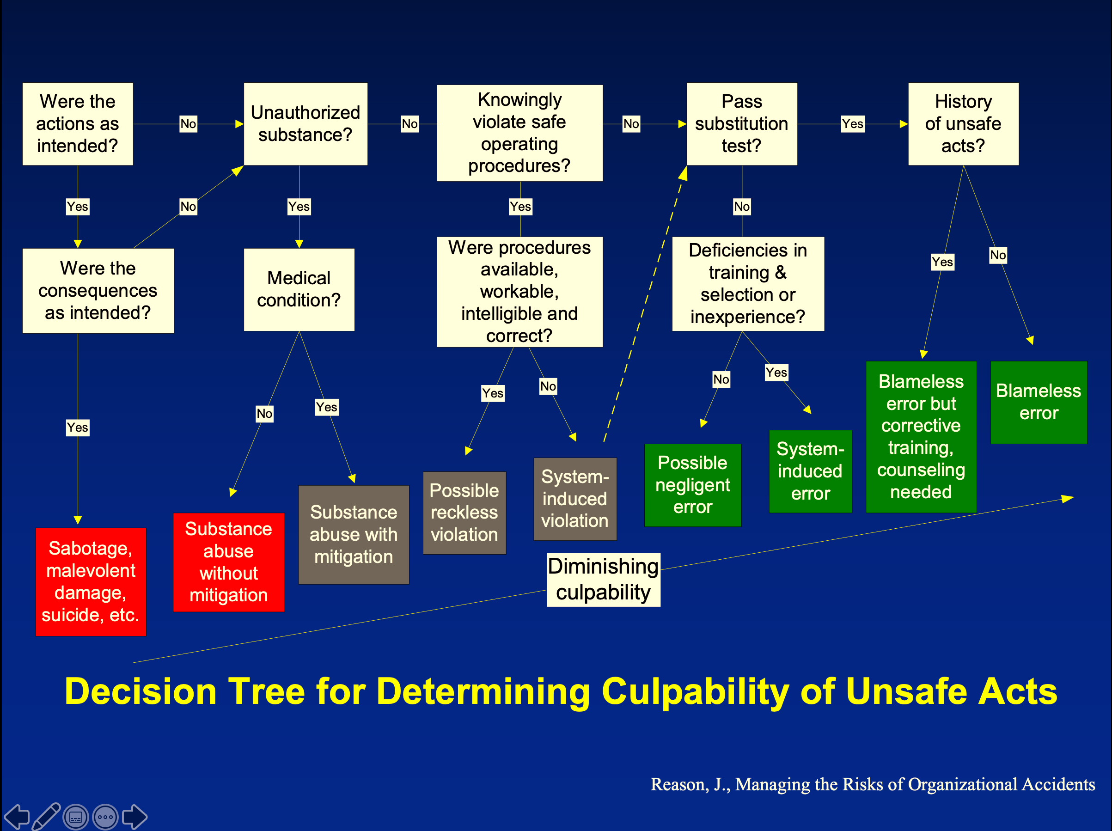



Important: Just Culture is NOT 100% blame-free! Events are investigated and personal accountability remains.

Slide 18
The Just Culture Model iN HEALTHCARE
Human Error |  | At-Risk Behaviour |  | Reckless Behaviour
Inadvertent action: slip, lapse or mistake Manage through changes in: Processes Procedures Training Design Environment |  | A choice: risk not recognized or believed insignificant or justified Manage through: Removing incentives for at-risk behaviors Creating incentives for healthy behaviors Increasing situational awareness |  | Conscious disregard of substantial and unjustified risk Manage through: Remedial action Disciplinary action
CONSOLE |  | COACH |  | DISCIPLINE
https://www.ahrq.gov/hai/cusp/modules/apply/ac-cusp.html

Slide 19
Violations
Deliberate deviation from necessary practice
Sometimes violations are justifiable
Violation is more effective
Following policy is not appropriate in the situation
(Poor) system design prevents following policy
Examples within EPIC:
Disregarding warnings re drug allergies (hydromorphone warning if codeine allergy/sensitivity)
Disregarding contraindication warnings for pregnancy (for postop C/S orders)

Slide 20
High Reliability Organizations (HRO’s)
An organization that succeeds in avoiding catastrophes despite a high level of risk and complexity
Ex’s: air traffic control, nuclear power plants, healthcare orgs
Characteristics
Preoccupied with failure: latent issues and small errors promptly reported
Reluctance to simplify interpretations: recognize complexity of system
Sensitivity to operations: situational awareness re conditions on frontline
Commitment to resilience: ability to detect errors, improvise and recover
Deference to expertise: expertise overrides typical rank in crisis situations

Slide 21
Adverse Event Detection
Multiple sources:
Adverse event (SLS) reports (mandatory, voluntary)
Chart reviews
Informal communications
Automated surveillance of clinical data
Voluntary A/E reporting represents a VERY small fraction of true events! (% of true events depends on safety culture)
Cluster of repeated, similar A/E’s (involving different individuals) indicates a definite systemic issue that needs attention

Slide 22
Anesthesia Department QPS Committee
Reviews adverse events, near misses and identified latent hazards
Investigates A/E’s re contributing factors
Makes recommendations re risk reduction strategies
Initiates QI projects
Informs/educates department members re quality/safety issues
Represents dept at hospital level QPS Committee

Slide 23

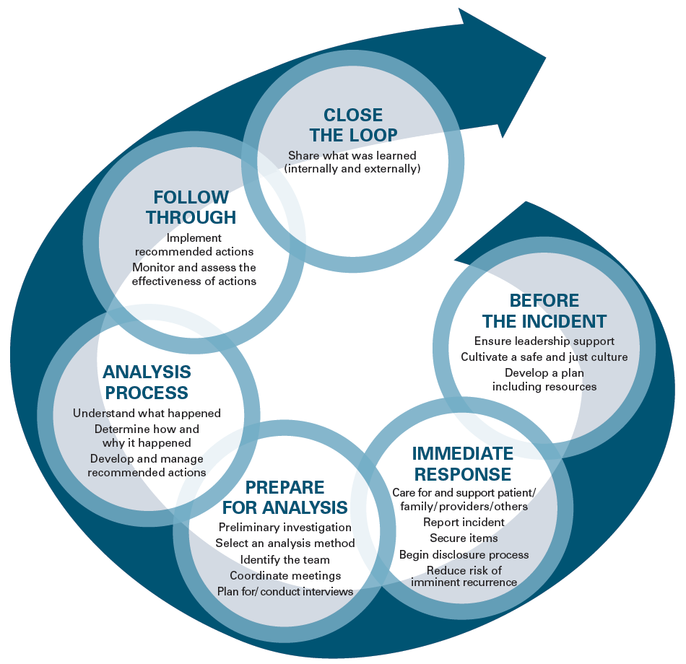
Prepare for Analysis:
Preliminary investigation
Identify analysis team
Conduct interviews
Analysis Process:
What happened?
How and why?
Develop and manage recommended actions

Slide 24
Incident Analysis
Multidisciplinary (retrospective) investigation of an adverse event
Facilitated by team member skilled in incident analysis
Opportunity for providers to reflect and learn
Structured analysis to determine:
Event timeline (“what”, “when” and “how”)
Contributing factors / root causes (“why”)
Output: recommendations for system improvements to prevent a recurrence

Slide 25
Adverse Event Analysis Tools
5 Why’s
Fishbone (Ishikawa) diagram
Constellation Diagram
Process mapping
Failure Mode and Effects Analysis (FMEA)
Pareto Analysis

Slide 26
Tool #1: 5 Whys
An iterative interrogative technique using WHY questions to explore cause/effect relationships underlying a particular problem
Number 5 based on the observation that @ 5 layers of questions often gets to the root
Focuses on processes, not people
The deeper questions will ultimately point to a process issue
If a problem has multiple root causes it will require multiple lines of “why” questioning

Slide 27
5 Why’s
Risk of Recurrence
Why?
Late for Work
Why?
Woke Up Late
Why?
Alarm Clock Didn’t Work
Why?
Battery Died
Why?
Didn’t Replace
Caught Speeding
Improvement Inertia

Slide 28
5 Why’s: Healthcare Example
Why did the patient receive the wrong treatment?
They arrived in PACU without an ID band and an incorrect order was carried out
Why did the patient arrive to PACU without identification?
The wrist band was removed in the OR and not replaced
Why was it not replaced?
The wristband printer at the front desk was not working
Why was the printer not working?
IT was called but they didn’t come by to fix it
Why did IT not come to fix it?
IT resources were cut and they’re now unable to respond in a timely fashion

Slide 29
Tool #2: Fishbone (Ishikawa) Diagram
Originally created by Kaoru Ishikawa (1915-1989)
Organizational theorist, professor of engineering
Recognizes that bad outcomes have multiple contributing factors
Factors are grouped into major categories
Causal diagram:
Is produced by brainstorming with a team of knowledgeable stakeholders (frontline input critical)
Provides information at a glance
Limitation: only produces a list (doesn’t show relationships between factors)

Slide 30
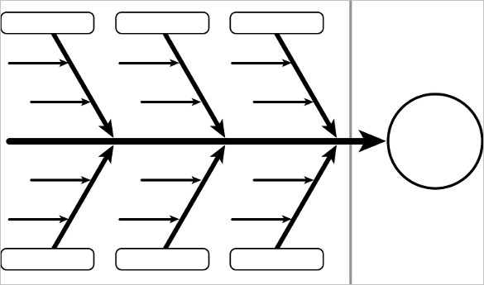
Fishbone/Ishikawa Diagram

Slide 31
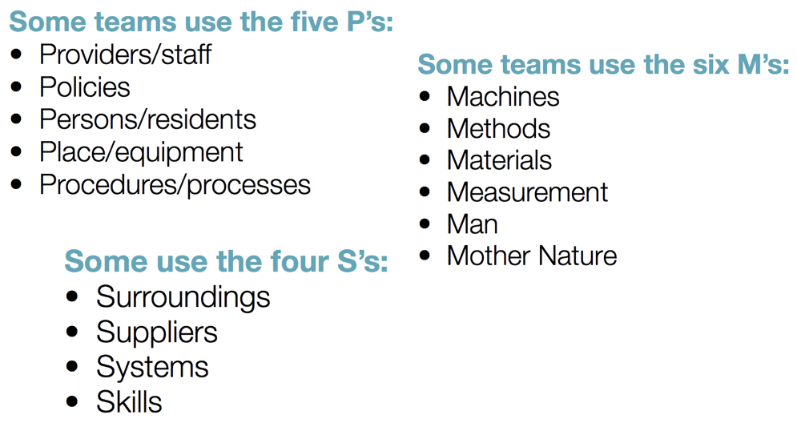
Ishikawa Diagram: examples of main categories

Slide 32
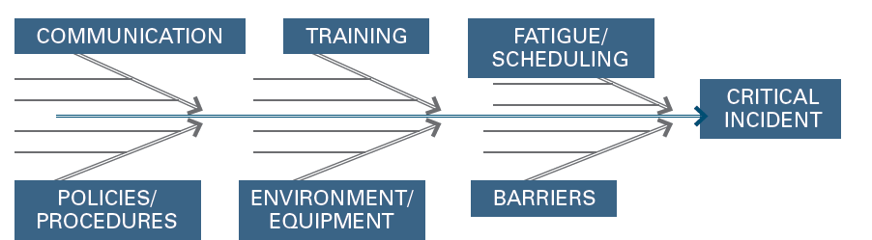
Fishbone for Critical Incidents…

Slide 33
Fishbone – subcategory examples
People
knowledge, training, behavior, supervision, attitudes
Environment
staffing, workload, admin support, policies/regulations, culture
Equipment
any tools/technology: design, user interface, functionality
Materials management
equipment supply/availability, maintenance
Methods and Process
steps in care process, workflow, protocols

Slide 34
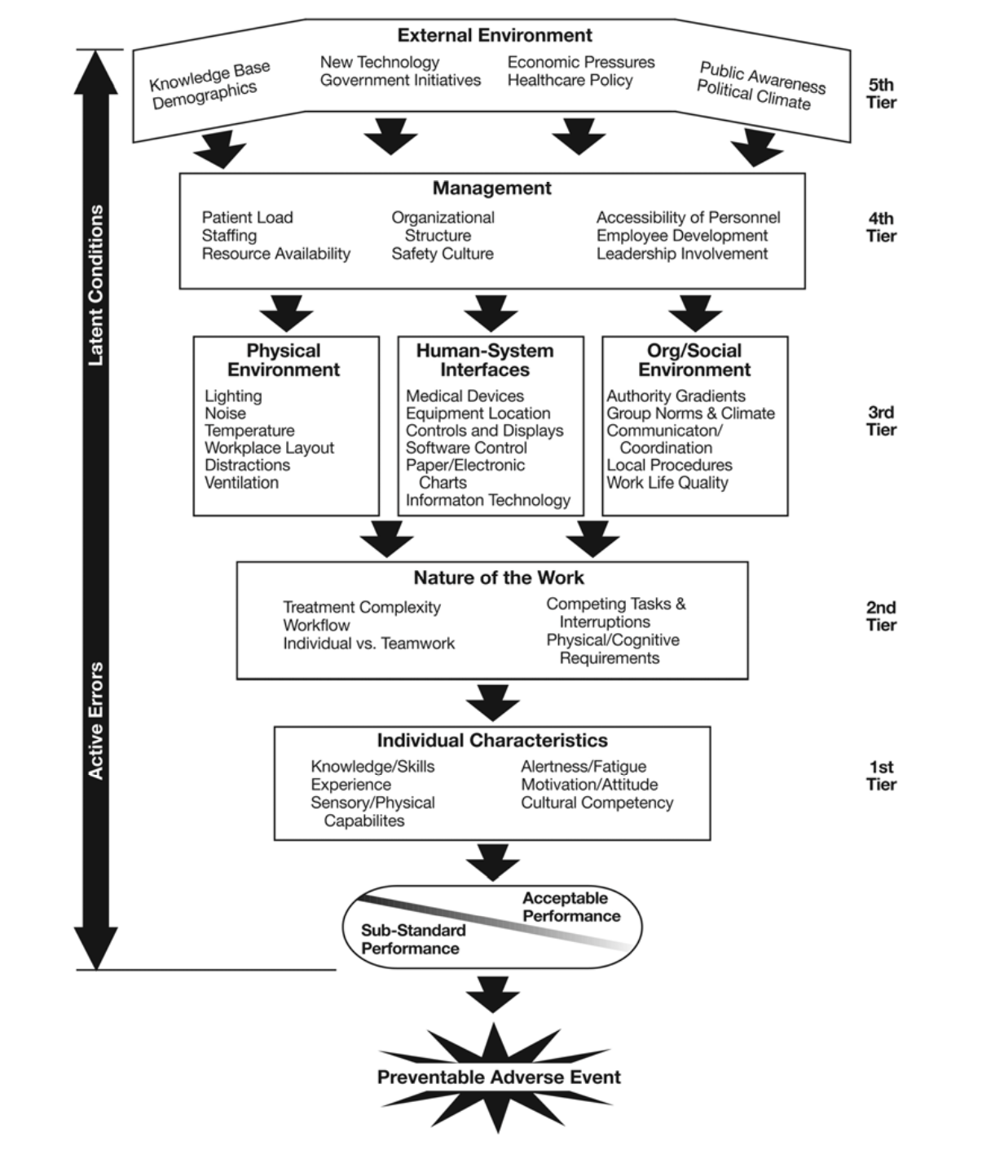
Contributing Factors
More detailed view of foundational and individual circumstances that may contribute to an adverse event
https://www.researchgate.net/publication/49843292_Understanding_Adverse_Events_A_Human_Factors_Framework

Slide 35
Tool # 3: Constellation Diagram
Uses contributing factors (like Fishbone) but includes information about the relationships between the factors
Very useful when considering effects of a change (intervention) on other parts of the system

Slide 36
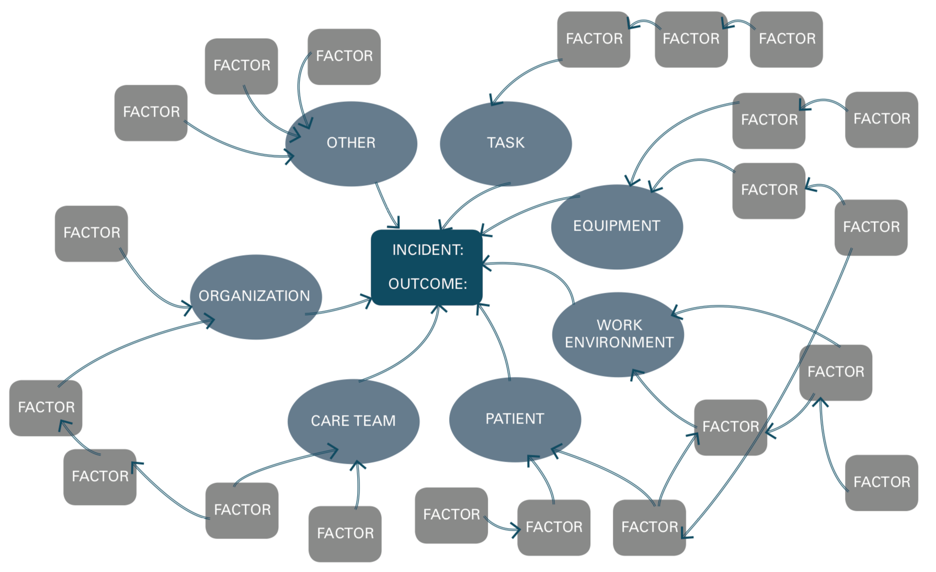
Constellation Diagram
Adapted from: CPSI’s Canadian Incident Analysis Framework

Slide 37
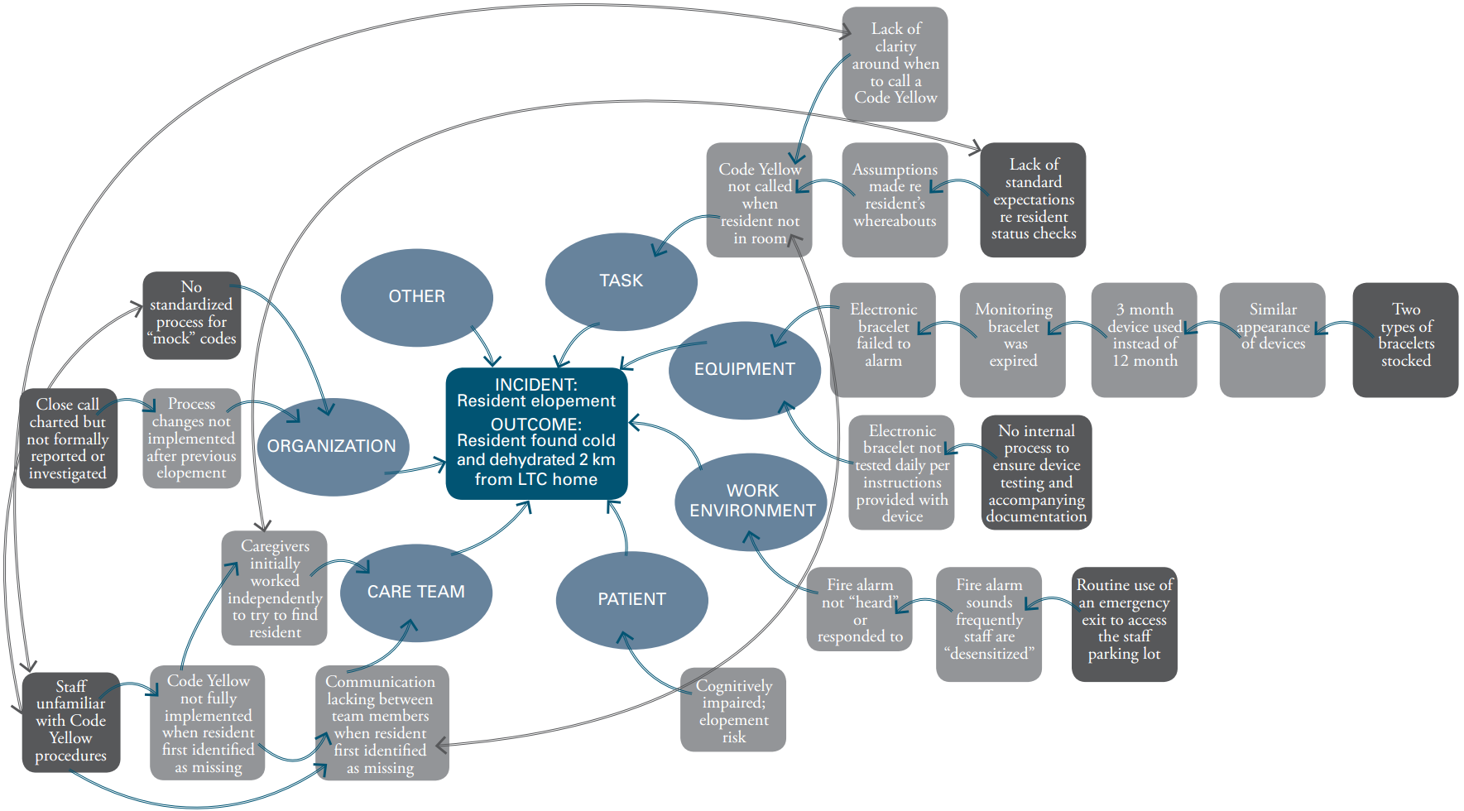
Constellation Diagram
INCIDENT:
Patient elopement
OUTCOME:
Patient found cold and dehydrated 2 km from LTC home
Adapted from: CPSI’s Canadian Incident Analysis Framework

Slide 38
Tool #4: Process Mapping
Define a process and identify steps in detail
Gather multisource information about each step
Chart the steps (examples of chart types):
Workflow charts
Value stream maps
Analyze the steps
Recommend changes to:
Increase efficiency (reduce/combine steps)
Reduce error rates
Reduce resource waste

Slide 39
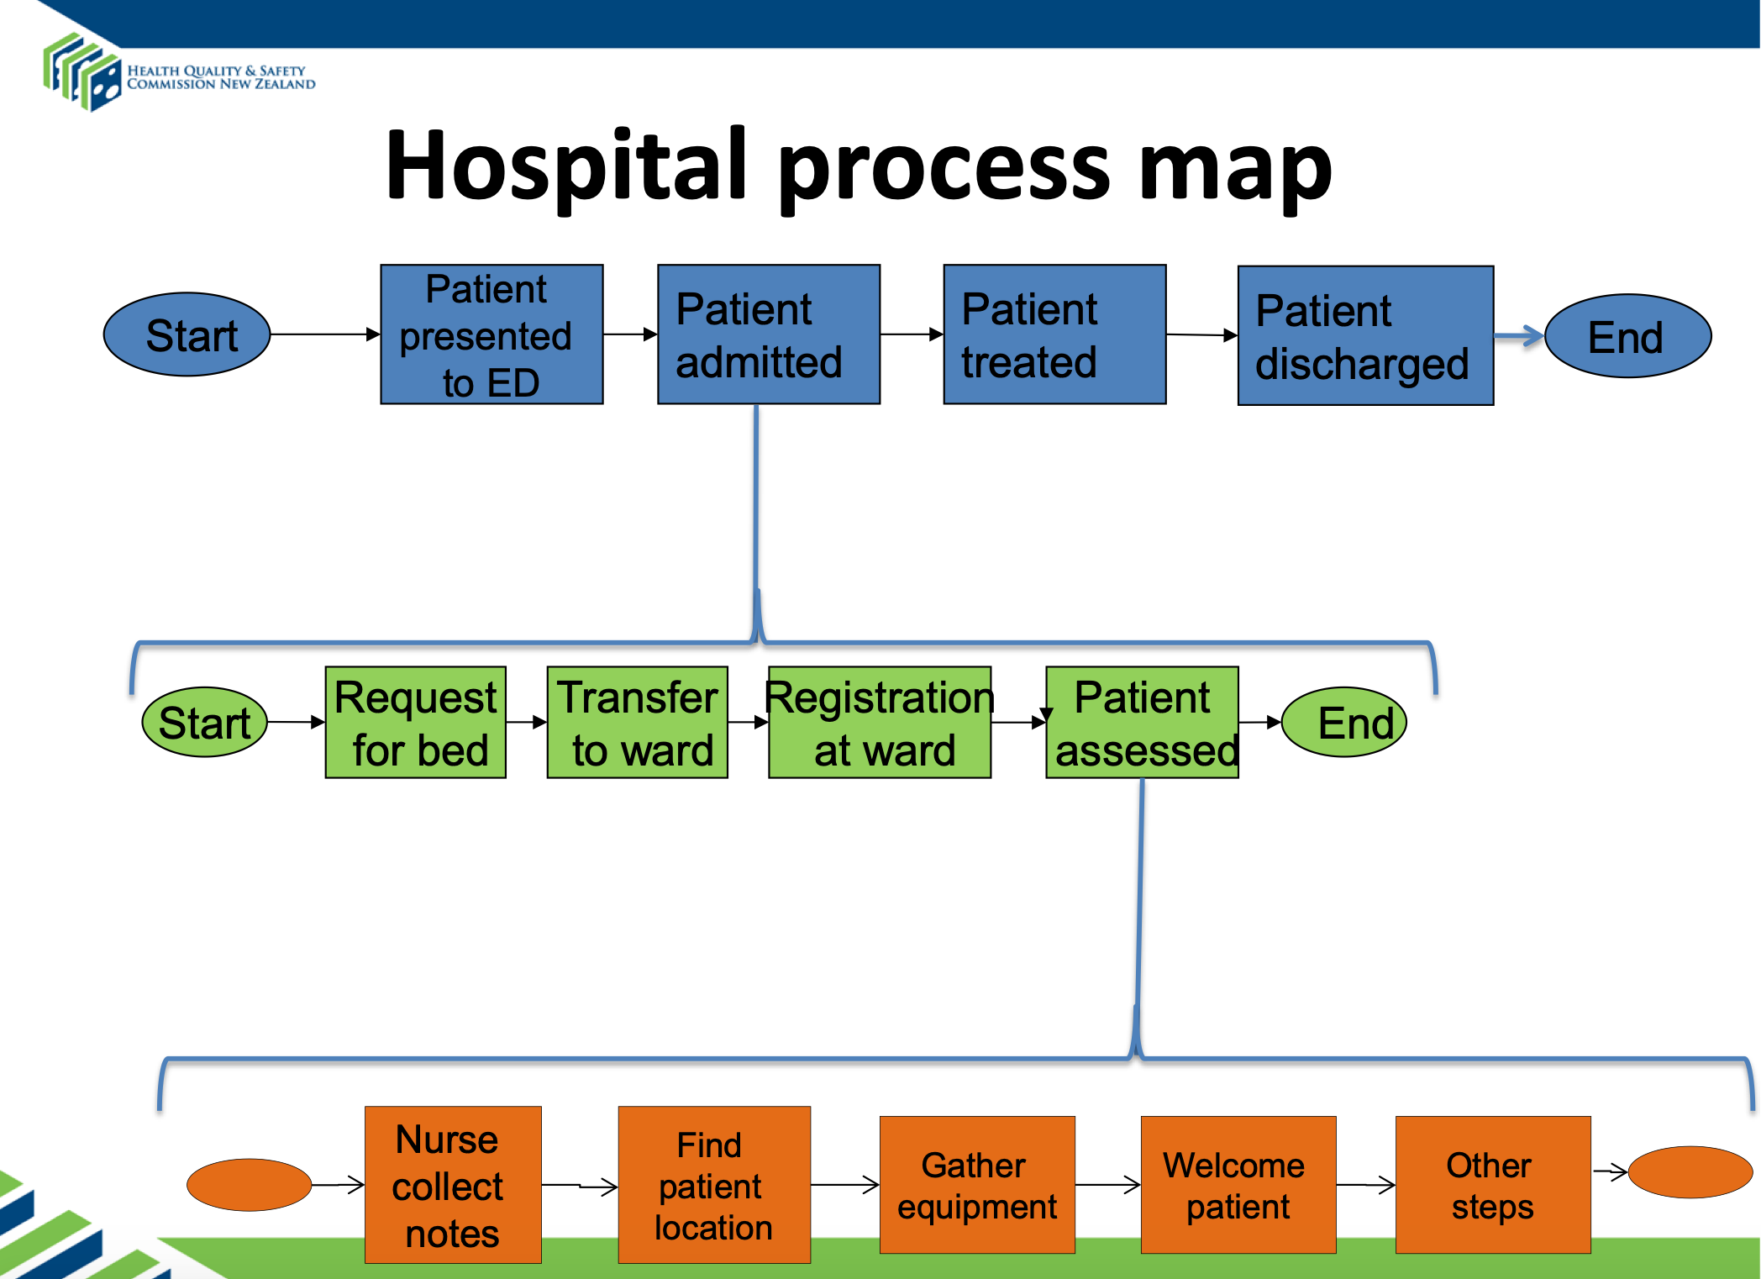
Process Map: Healthcare Example
Each step on higher level sequence can be broken down into component steps
Add players involved
Identify pain points (delays, inefficiencies, redundancies)
https://www.hqsc.govt.nz/assets/Medication-Safety/collaborative/PR/LS1/004-process-mapping-Prem-Kumar.pdf

Slide 40
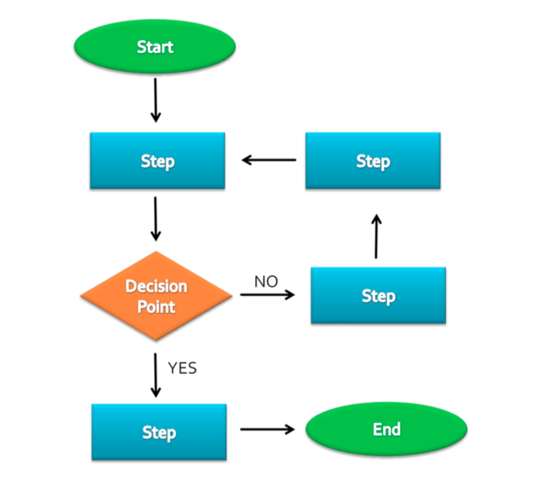
Process Mapping
Examples of process issues:
-Why does a PAU clinic appt last 4 hours?
-How was the Cardiology referral lost?
-Why did the PRBC’s get sent to the wrong OR?

Slide 41
Tool #5: Failure Mode and Effects Analysis (FMEA)
Long Hx of use in military, engineering
Prospectively analyzing the specific way that a failure occurs
Failure can be of a:
Component part
Function
System or subsystem
Effects analysis looks at effects of failure modes on different system levels
Ideally utilized during the design process (e.g. medical equipment, software) to improve reliability, minimize failures and their impact

Slide 42
Tool #6: Pareto Analysis
When analyzing a recurrent problem, goal is to identify the leading cause(s) when variety of causes already recognized
Chart the frequency of each of the underlying causes
Recognize that although there are many different causes, most problems (@ 80%) arise from a select few causes (20%)
Known as the “80:20 rule” (Vilfredo Pareto)
Pareto chart helps to target most effective interventions

Slide 43
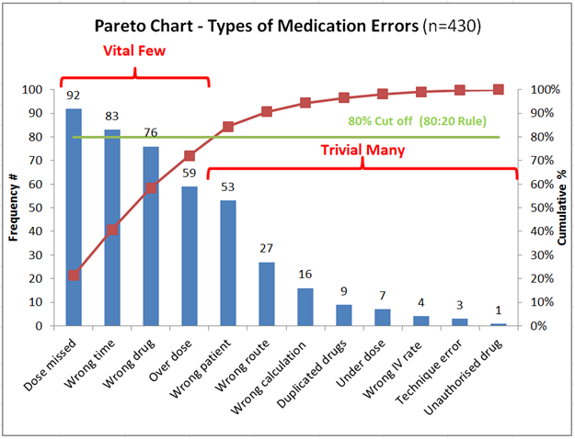
Pareto Chart
To track the most important causes
Bars = frequency or cost of a factor
Brown line = cumulative total

Slide 44
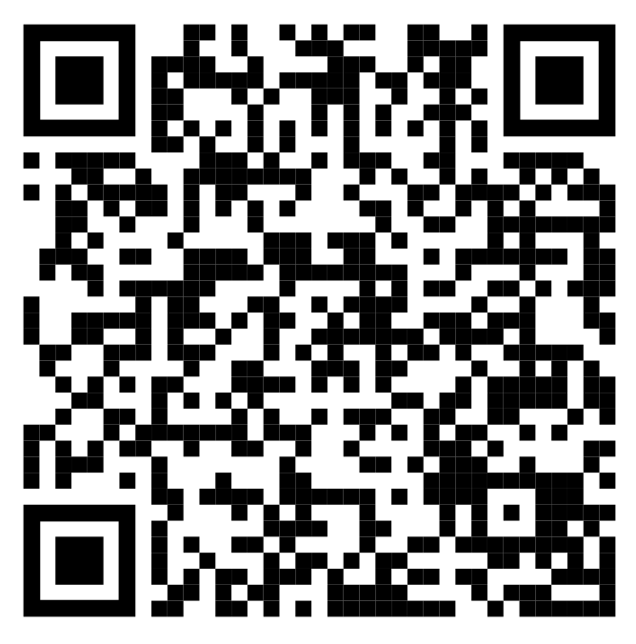
Discussion prep
You’ll be using the Fishbone diagram for an exercise so print slide 29 to jot down your ideas or go to:
http://www.ihi.org/resources/Pages/Tools/CauseandEffectDiagram.aspx
(Jump to Downloads) to download a blank, fillable electronic form

Slide 45
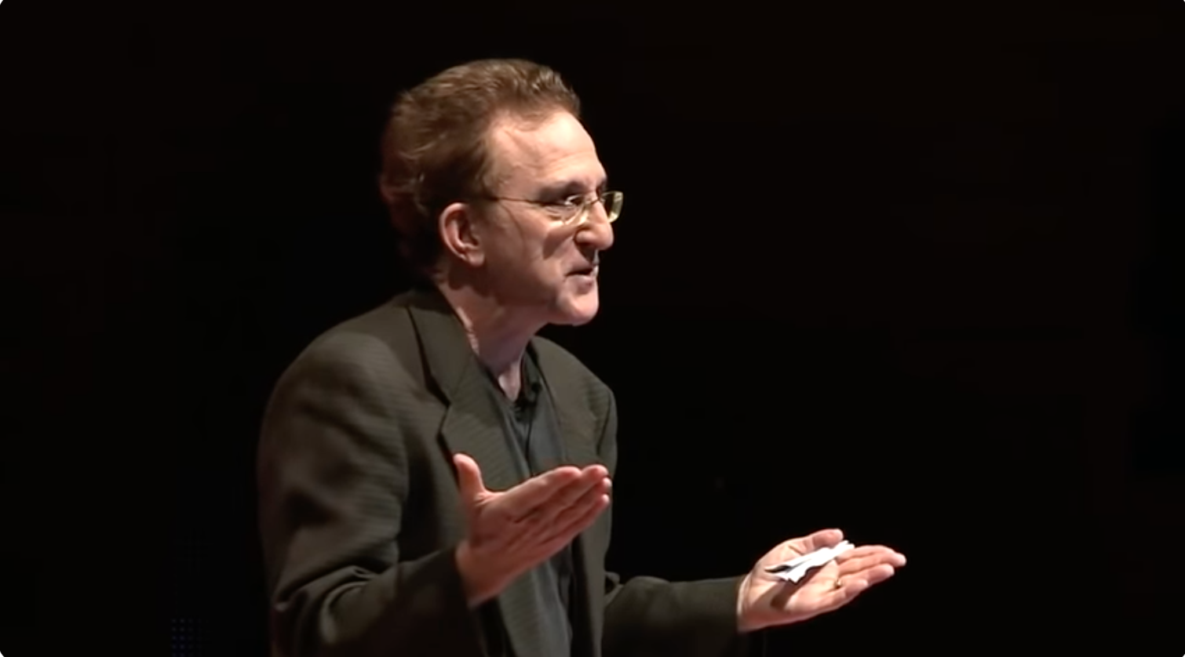
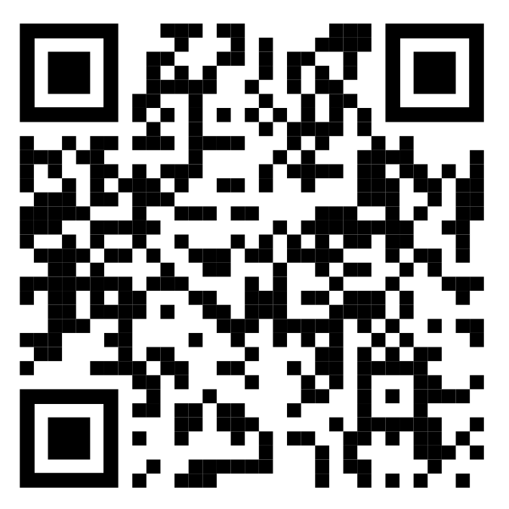
Watch this TEDx Video
Doctor Make Mistakes, Can We Talk About That?, Dr. Brian Goldman
https://youtu.be/iUbfRzxNy20?feature=shared (19.5 mins)

Slide 46
References
https://thesystemsthinker.com/sectors/healthcare/
https://en.wikipedia.org/
Royal College ASPIRE Course material (Advancing Safety for Patients in Residency Education)
https://www.royalcollege.ca/en/events/advancing-safety-patients-in-residency-education-aspire.html

Slide 47
The End

Slide 48
This work is licensed under CC BY-NC-SA 4.0. To view a copy of this license, visit: https://creativecommons.org/licenses/by-nc-sa/4.0/

